Slide 1
PRESENTATION TITLE
Mirjam Nilsson

Slide 2
AGENDA
Introduction
Primary goals
Areas of growth
Timeline
Summary

Slide 3
INTRODUCTION
At Contoso, we empower organizations to foster collaborative thinking to further drive workplace innovation. By closing the loop and leveraging agile frameworks, we help business grow organically and foster a consumer-first mindset.​

Slide 4
PRIMARY GOALS
Annual revenue growth

Slide 5
Sales by package Sizes

Slide 6
Customers Total Sales Demographics
No | Life Stage | Premium Customer | Total Sales
1 | OLDER FAMILIES | Budget | 156863.75
2 | YOUNG SINGLES/COUPLES | Mainstream | 147582.20
3 | RETIREES | Mainstream | 145168.95
4 | YOUNG FAMILIES | Budget | 129717.95
5 | OLDER SINGLES/COUPLES | Budget | 127833.60
6 | OLDER SINGLES/COUPLES | Mainstream | 124648.50
7 | OLDER SINGLES/COUPLES | Premium | 123537.55
8 | RETIREES | Budget | 105916.30
9 | OLDER FAMILIES | Mainstream | 96413.55
10 | RETIREES | Premium | 91296.65

Slide 7
Customers Total Sales Demographics
No | Life Stage | Premium Customer | Total Sales
11 | YOUNG FAMILIES | Mainstream | 86338.25
12 | MIDAGE SINGLES/COUPLES | Mainstream | 84734.25
13 | YOUNG FAMILIES | Premium | 78571.70
14 | OLDER FAMILIES | Premium | 75242.60
15 | YOUNG SINGLES/COUPLES | Budget | 57122.10
16 | MIDAGE SINGLES/COUPLES | Premium | 54443.85
17 | YOUNG SINGLES/COUPLES | Premium | 39052.30
18 | MIDAGE SINGLES/COUPLES | Budget | 33345.70
19 | NEW FAMILIES | Budget | 20607.45
20 | NEW FAMILIES | Mainstream | 15979.70
21 | NEW FAMILIES | Premium | 10760.80

Slide 8
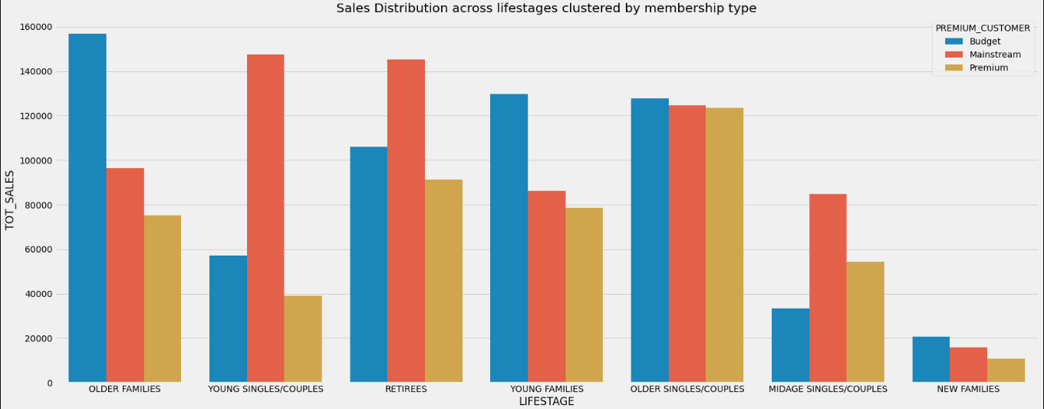
Sales distribution Across Life stages clustered membership type

Slide 9
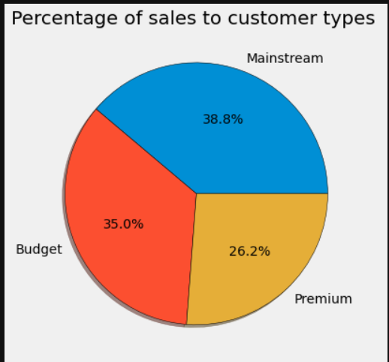
Percentage of sales to customer Groups

Slide 10
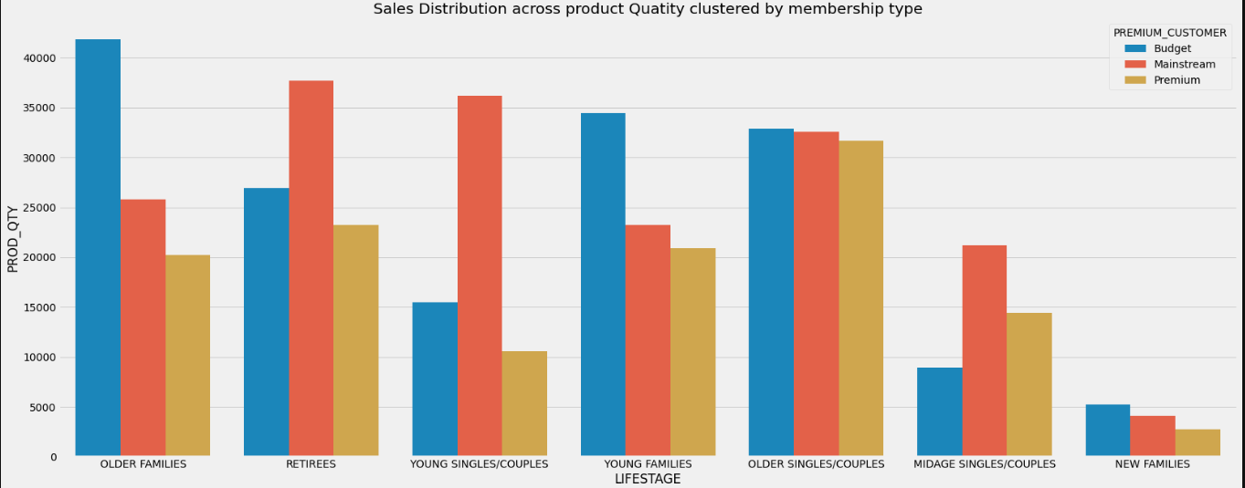
Sales Distribution by product Quantity Clustered by Membership Type

Slide 11
TIMELINE
Q1
Synergize scalable e-commerce
Q2
Coordinate e-business applications
Q3
Deploy strategic networks with compelling e-business needs
Q4
Disseminate standardized metrics

Slide 12
AREAS OF FOCUS
B2B MARKET SCENARIOS
CLOUD-BASED OPPORTUNITIES
Develop winning strategies to keep ahead of the competition
​Capitalize on low hanging fruit to identify a ballpark value
​Visualize customer directed convergence​
Iterative approaches to corporate strategy
​Establish a management framework from the inside​

Slide 13
HOW WE GET THERE
ROI
NICHE MARKETS
SUPPLY CHAINS
Envision multimedia-based expertise and cross-media growth strategies​
​Engage worldwide methodologies with web-enabled technologies​
Pursue scalable customer service through sustainable strategies​
Engage top-line web services with cutting-edge deliverables​​​
Cultivate one-to-one customer service with robust ideas​
Maximize timely deliverables for real-time schemas​

Slide 14
SUMMARY
At Contoso, we believe in giving 110%. By using our next-generation data architecture, we help organizations virtually manage agile workflows. We thrive because of our market knowledge and great team behind our product. As our CEO says, "Efficiencies will come from proactively transforming how we do business."​

Slide 15
THANK YOU
Mirjam Nilsson
mirjam@contoso.com
www.contoso.com

